Slide 1
Happy Go Lucky Introduction
Dirk Riehle, FAU Erlangen
ADAP C01
Licensed under CC BY 4.0 International

Slide 2
Happy Go Lucky Vision
Happy Go Lucky (HGL) is
A web app to support our project based teaching
Original HGL solutions are
Happiness index
Standup emails
Code tracking

Slide 3
Setup and Test of Happy Go Lucky
Fork happy-go-lucky to your account, e.g. friedalex
git clone git@github.com:friedalex/happy-go-lucky.git
cd happy-go-lucky
npm install
npm run build
npm run test
npm run generate-mockdata
npm run test
npm run dev

Slide 4
Happy Go Lucky Base Design
HGL is a web app to support our project based teaching
An admin (professor) can create courses (by semester)
A course can have one or more projects associated with it
A course has an associated schedule (homework delivery dates)
A project can have one or more members (ADAP = 1, AMOS = 6..12)
A project is linked to exactly one GitHub repository

Slide 5
ADAP and AMOS
ADAP
One course for a given term
Each student their own project
Students can create their project
AMOS
One course for a given term
Small number of set projects
Students join existing project

Slide 6
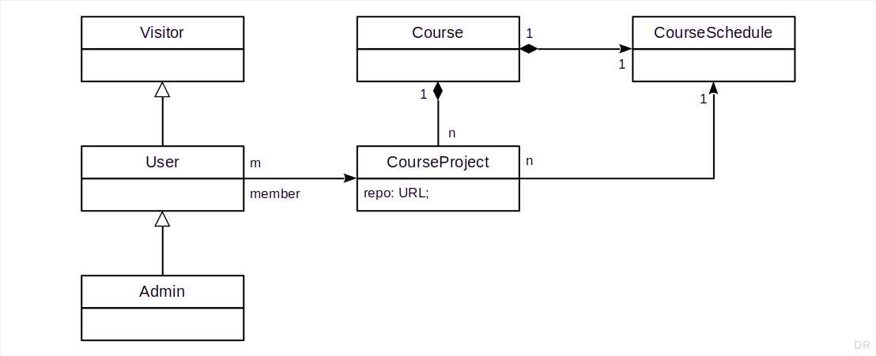
Class Model (Logically)

Slide 7
Original HGL Solutions
For a given project, a member
Can enter their happiness
Can send out stand-up emails
Can review their coding activities
all scoped by the course schedule

Slide 8
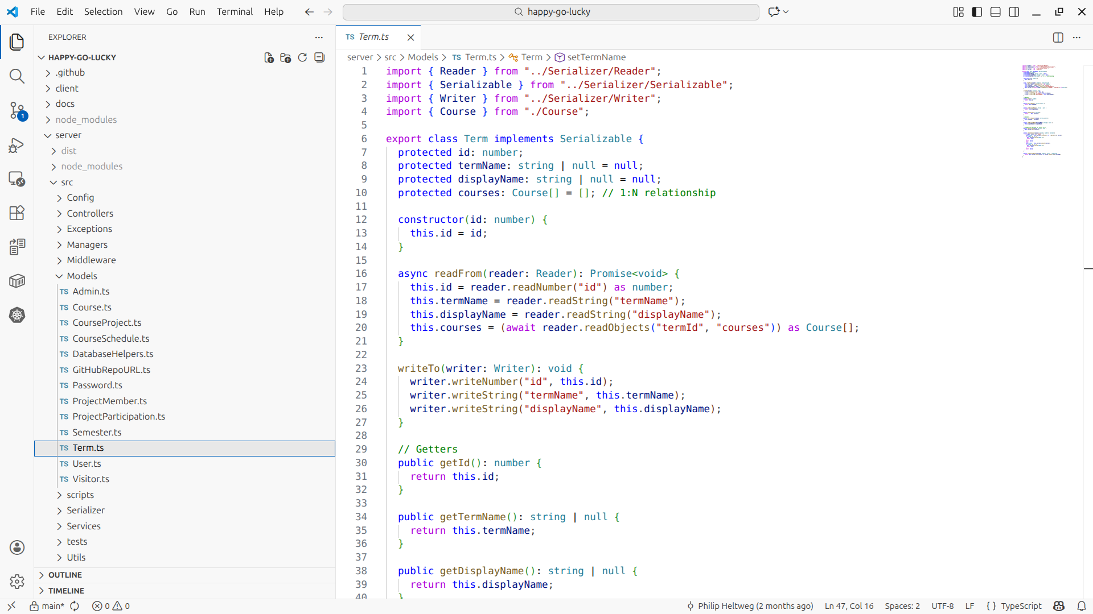
Use Your Fav IDE But Keep Cruft Out

Slide 9
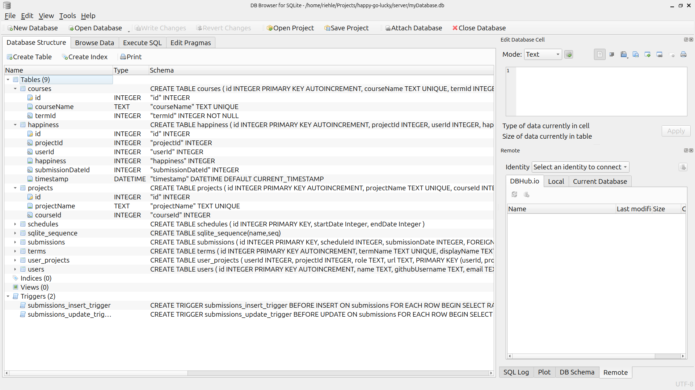
SQLite Database Browser (myDatabase.db)

Slide 10
Optional Homework
See this table (same as project, but use table)
https://docs.google.com/spreadsheets/d/1Td5wvsGZAJnNZjEvm8cfsthcylOhCpth3aT8vSCUZk0/edit?usp=sharing
You will not be penalized if you don’t participate
You’ll get extra credit if you participate
Extra credit might lift your grade if you are at a grade boundary
View this experience as an idea of your first industry job

Slide 11
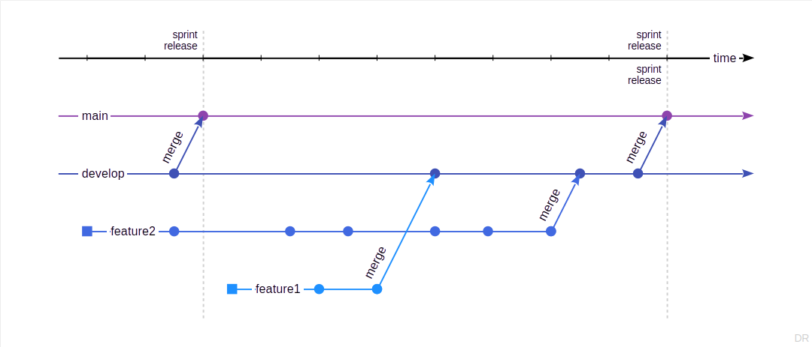
Working With Branches

Slide 12
Homework Work and Git Flow
Fork and work from your own repository
Pick and mark item to work on (spreadsheet)
Create a branch and a WIP pull request where you explain what you are going to do (to get feedback early on, discuss design alternatives, …)
  Source branch: feature branch on your repo
  Target branch: develop-ADAP-12 on riehlegroup/happy-go-lucky
  Tag @georg-schwarz for feedback
Semantically chunk work into commits
Make sure the checks (GitHub Actions) run through successfully
When done, remove WIP status
Wait and incorporate code review feedback (amend pull request)
Your work may or may not be integrated

Slide 13
Thank you! Any questions?
dirk.riehle@fau.de – https://oss.cs.fau.de
dirk@riehle.org – https://dirkriehle.com – @dirkriehle

Slide 14
Legal Notices
License
Licensed under the CC BY 4.0 International license
Copyright
© 2012-2026 Dirk Riehle, some rights reserved

